Slide 1
Steps needed
Step 1: look into the https://elements.envato.com/hai-elementor-agency-wordpresstheme-EEJ7CV5
See if it’s 1 time payment or monthly payment?
If there is no way for 1 time payment, does this theme exist somewhere else for 1 time payment? Maybe contact good fiver guys with good reviews and maybe they have it?
Last resort: Do it ourselves on Wordpress

Slide 2
Step 2: come up with names for the center
For now name is:
UCLA AI Research and Software Development Center
Center for AI Research (UCLA CAIRE)
Let me know other possible good names

Slide 3
Step 3: once we have the theme in place, just fill in data

Slide 4

UCLA AI Research and Software Development Center
General demo video
https://elements.envato.com/hai-elementor-agency-wordpresstheme-EEJ7CV5
https://wdtwpthemes.wpengine.com/hai/home-creative-agency/

Slide 5

https://elements.envato.com/hai-elementor-agency-wordpresstheme-EEJ7CV5
https://wdtwpthemes.wpengine.com/hai/home-creative-agency/

Slide 6

THIS IS A VIDEO
https://wdtwpthemes.wpengine.com/hai/

Slide 7

https://elements.envato.com/hai-elementor-agency-wordpresstheme-EEJ7CV5
https://wdtwpthemes.wpengine.com/hai/home-creative-agency/

Slide 8

Projects short videos:
PSIM
WISE
FireRisk
Phoenix
PCAT
PISRAM
V2X
PSIM
General demo video
https://wdtwpthemes.wpengine.com/hai/home-startup-business/

Slide 9

https://elements.envato.com/hai-elementor-agency-wordpresstheme-EEJ7CV5
https://wdtwpthemes.wpengine.com/hai/home-creative-agency/

Slide 10
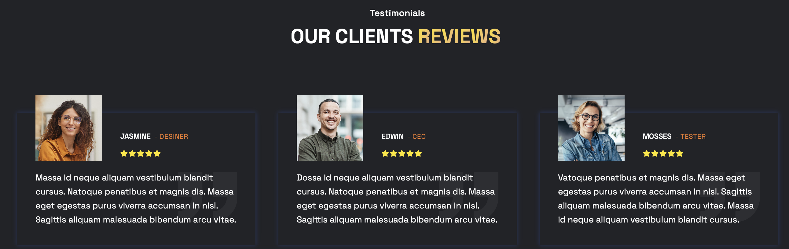
https://elements.envato.com/hai-elementor-agency-wordpresstheme-EEJ7CV5
https://wdtwpthemes.wpengine.com/hai/home-creative-agency/

Slide 11

https://wdtwpthemes.wpengine.com/hai/home-startup-business/

Slide 12

For partnerships or Internship Opportunities
https://wdtwpthemes.wpengine.com/hai/home-startup-business/

